Slide 1
PRIVACY
PRESERVING LOCATION
DATA PUBLISHING

Slide 2
TABLE OF CONTENTS
INTRODUCTION
SYSTEM ANALYSIS PROPOSED APPROACH
SOFTWARE AND HARDWARE REQUIREMENTS FLOW CHART
RESULTS CONCLUSION

Slide 3

INTRODUCTION
Publication of data by different organizations and institutes is crucial for open research and transparency of government agencies. Unfortunately, the process of data publication can be highly risky as it may disclose individuals sensitive information. Hence, an essential step before publishing datasets is to remove any uniquely identifiable information from them.
However, such an operation is not sufficient for preserving the privacy of users.
Therefore, it is crucial to anonymize spatiotemporal datasets before publishing them to the public.

Slide 4
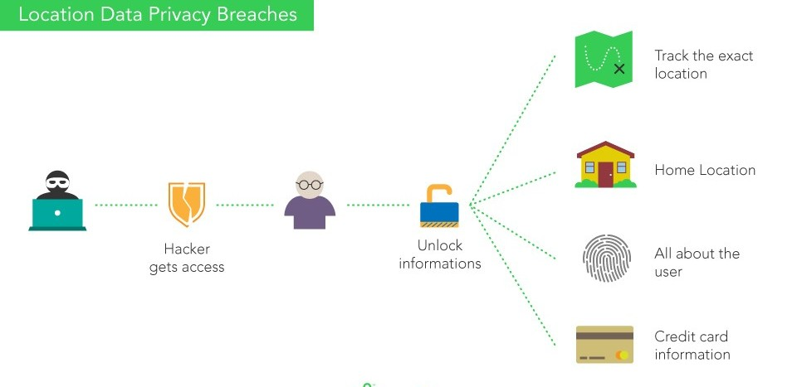

Slide 5
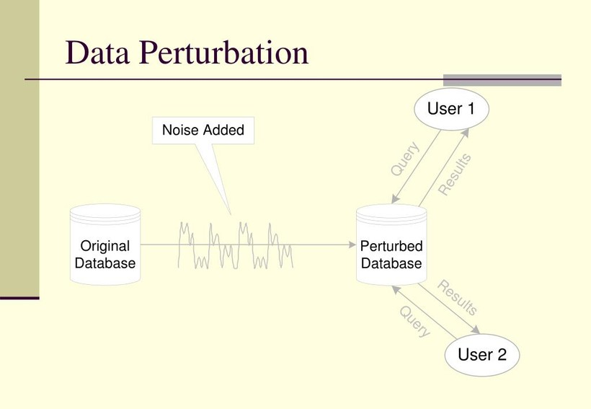
SYSTEM ANALYSIS
Numerous data anonymization techniques, including K-Anonymity and data perturbation, have been developed to protect user location. Data perturbation truncates user data while K-Anonymity combines data so user location cannot be determined.
Data Perturbation
Data perturbation techniques are statistically based approaches
that aim to secure sensitive data by introducing random noise to
confidential and numerical properties, hence preserving the
underlying data.
These are not encryption systems in which the data is first
transformed, then transferred, and then decrypted back to
the original data.

Slide 6
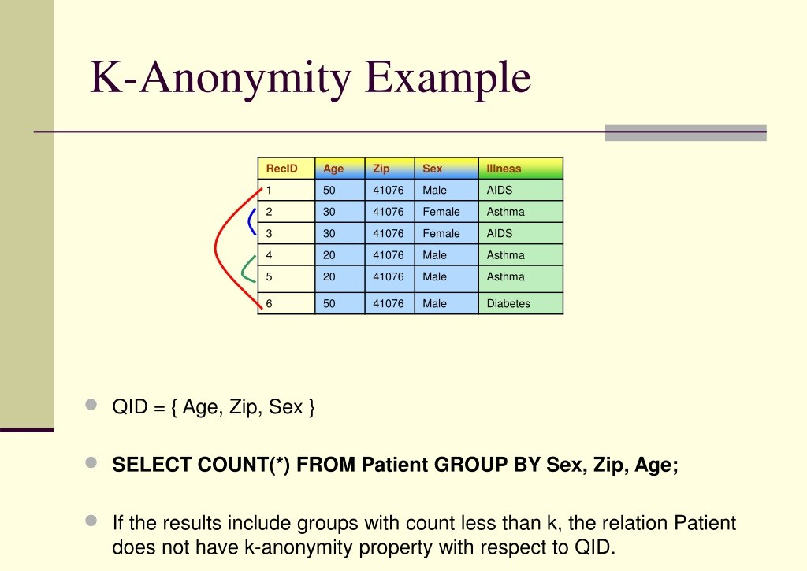
K-Anonymity
It is predicated on the idea that combining sets of data with related properties may make it possible to conceal identifiable details about any one of the individuals who contributed to the data.
Data releases are said to possess the k-anonymity property when no individual's information in the release can be distinguished from the information of at least k-1 other individuals whose identities also appear in the release.
K-anonymization is another name for the capability to "hide in the crowd.“
In order to avoid the re-identification of sensitive information, data owners who apply k-anonymization effectively might serve as a role model for others.

Slide 7
Drawbacks of existing system
The existing focuses on pair wise sequence alignment, which results in a high amount of information loss.
lack of a well-defined strategy for grouping trajectories because it is difficult to quantify
the cost of clustering when distances between trajectories rather than just locations are
taken into account.

Slide 8
PROPOSED APPROACH
We can develop a machine learning-based data privacy-preserving solution to get around this issue.
Three processes, namely clustering, alignment, and generalization, which offer greater security and anonymized or generalized datasets that are difficult to interpret and crack, make up the Machine Learning Anonymization (MLA) framework, which is used to anonymize spatiotemporal datasets.
Clustering
Clustering is used at the top level of the MLA architecture to find the best grouping of trajectories that minimizes information loss.
We suggest using the k-means clustering technique and using a heuristic approach to cluster datasets in order to create a baseline for comparison.

Slide 9
K-Means Clustering
K-means Clustering is a form of unsupervised learning that is applied to unlabeled data or information that lacks clearly defined categories or groupings. With the number of groups indicated by the variable K, the objective of this method is to locate groups in the data.
Market segmentation, document clustering, picture segmentation, and image compression are just a few examples of the many applications that employ the well-liked K-means technique. Usually, our objective while performing a cluster analysis is one of the following: to get a meaningful understanding of the data's structure.
Since it is a clustering method, k-Means divides the input data into k clusters. The grouping procedure is the method for the learning training phase. The outcome would be a model that, given a data sample as input, gives the cluster to which the new data point belongs in accordance with the training it underwent.

Slide 10

K-Means Clustering Alorithm
The working of the K-Means algorithm :
Step 1: To determine the number of clusters, choose K as the first step.
Step 2: At random, select K locations or centroids.
Step 3: Assign each data point to its nearest centroid, which will create the K clusters that have been predetermined.
Step 4: Determine the variance and relocate each cluster's centroid.
Step 5: Re-assign each data point to the new centroid of each cluster by repeating the above steps.
Step 6: Move to Step 4 if there is a reassignment; otherwise, go to Finish.
Step 7: The Finished Model.

Slide 11
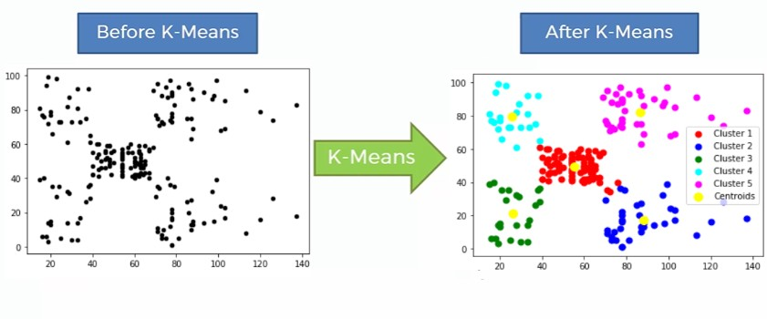

Slide 12
Affinity Propagation:
Affinity Propagation, unlike other standard clustering algorithms, does not require you to provide the number of clusters. In layman's terms, affinity propagation is a process in which each data point sends signals to all other data points, telling them of the relative attraction of each target to the sender.
Given the attractiveness of the messages it has received from all other senders, each target then replies to all senders with a reply, telling each sender of its readiness to associate with the sender. Senders respond to targets with messages notifying them of their modified desirability to the sender based on the availability of messages received from all targets.
The message-passing method continues until everyone agrees. When a sender is linked to one of its destinations, that target has now become the example for the point. All points that have the same reference are grouped together.

Slide 13
Alignment
In order to reduce the total cost of generalisation, the process of alignment is described as finding the best fit between two trajectories. We use a multiple SA approach dubbed "progressive SA" for anonymizing spatiotemporal trajectories.
The process of alignment between two trajectories has been investigated in several fields and is most commonly referred to as "sequence alignment" (SA). A greedy strategy for multiple SAs is a progressive SA. The method can select the trajectory resulting in the lowest loss during the alignment rather than selecting the trajectories at random during the progressive SA. The trajectories must be aligned pairwise as part of the method.
Dynamic SA is used to carry out the pairwise alignment procedure. For this, we employ dynamic SA. Dynamic SA works by breaking the task of determining the optimal SA into smaller ones and storing the answers in a table or matrix called the SAmatrix. The matrix will retain the grid cell's lowest cost.

Slide 14
Generalization
A well-known technique for publishing data while protecting privacy is generalization. The practice of generalization is a common defense against linked assaults. It operates by substituting duplicate forms for the original values in the micro data. By adding location and loss data, our model's user location will be generalized.
Our suggested framework bases the anonymization of the spatiotemporal datasets on the generalization approach. We employ the domain generalization hierarchy (DGH) trees to implement this method, and we quantify the information loss in line with that, By advancing up one or more DGH levels, any node on a DGH tree can be generalized.
Node-i → Node-j is a symbol for the process of generalizing node-i to one of its parent nodes. Suppression is a specific type of generalization in which the node is extended to the DGH's root.

Slide 15
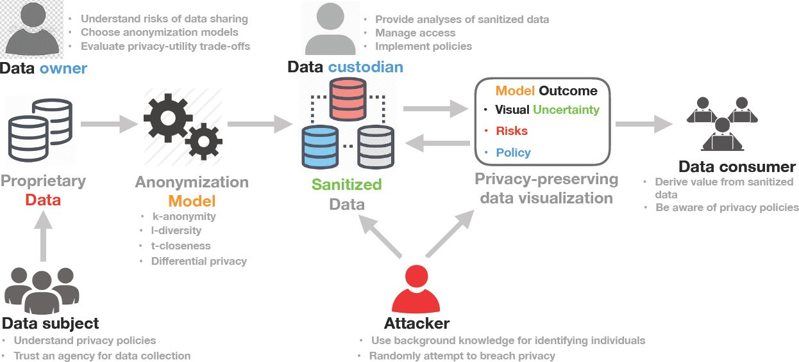

Slide 16

SOFTWARE REQUIREMENTS
Operating System - Windows 10
Coding Language – Python
GUI– TKINTER
HARDWARE REQUIREMENTS
Processor – Intel i5
RAM – 16 GB
Hard Disk – 512 GB

Slide 17
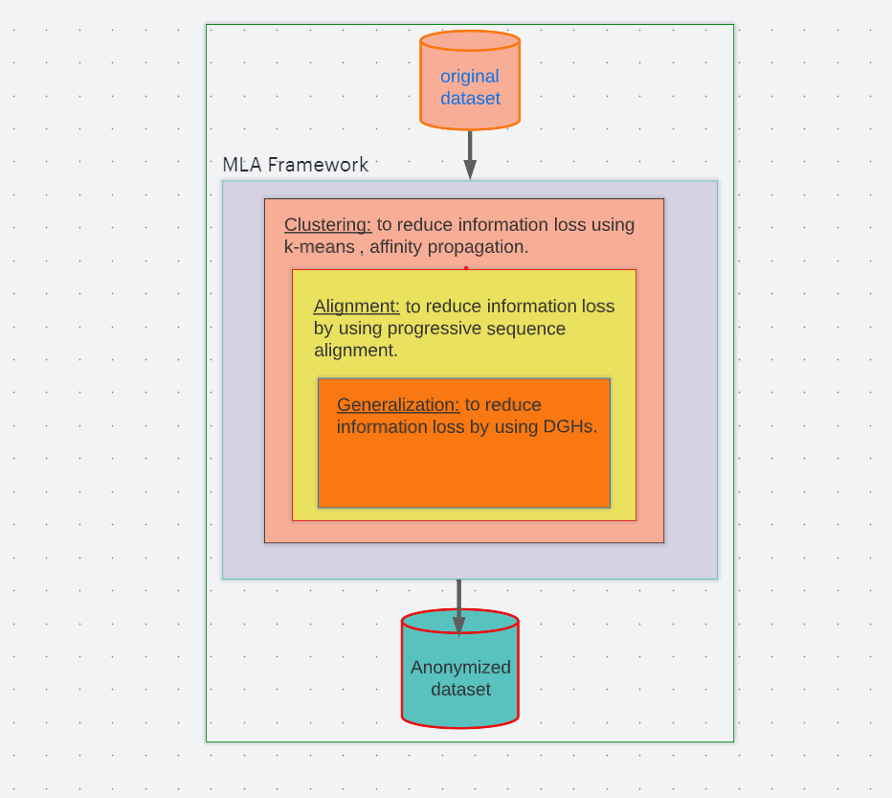
FLOW CHART

Slide 18
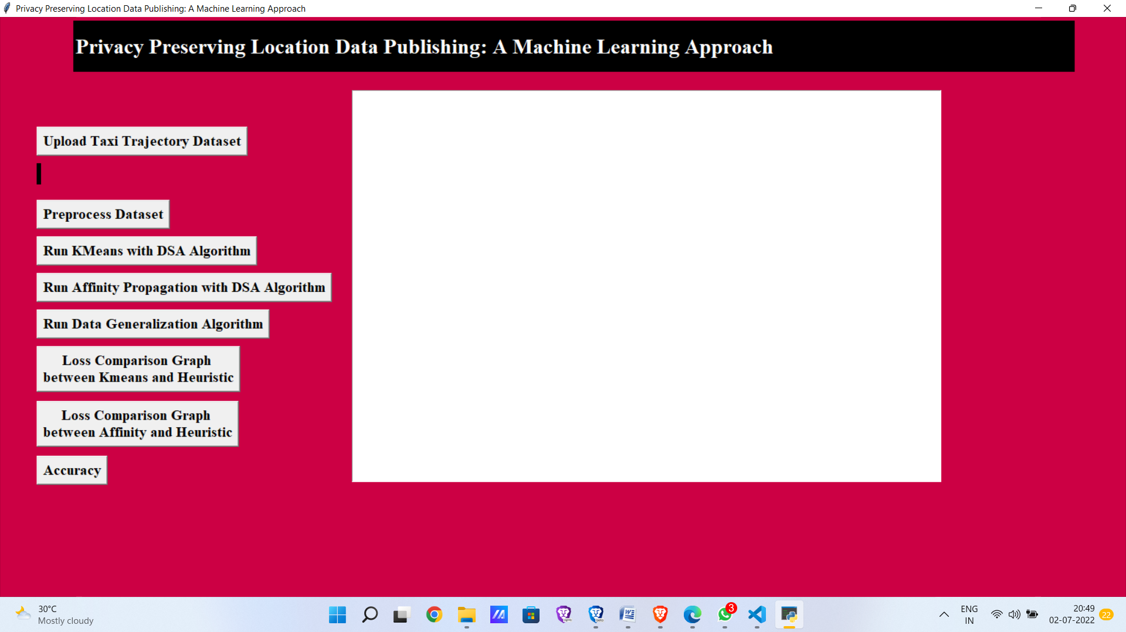
RESULTS
In above screen click on ‘Upload Taxi Trajectory Dataset’ button to upload dataset.

Slide 19
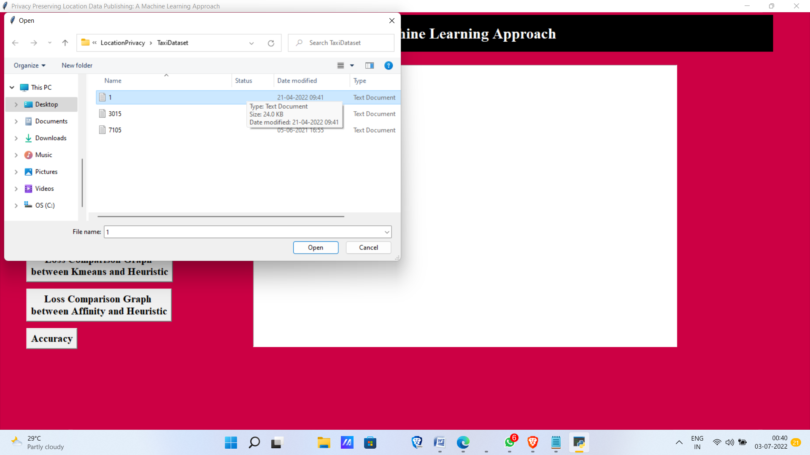
In above screen selecting and uploading taxi trajectory file and then click on ‘Open’ button to load dataset and to get below screen.

Slide 20
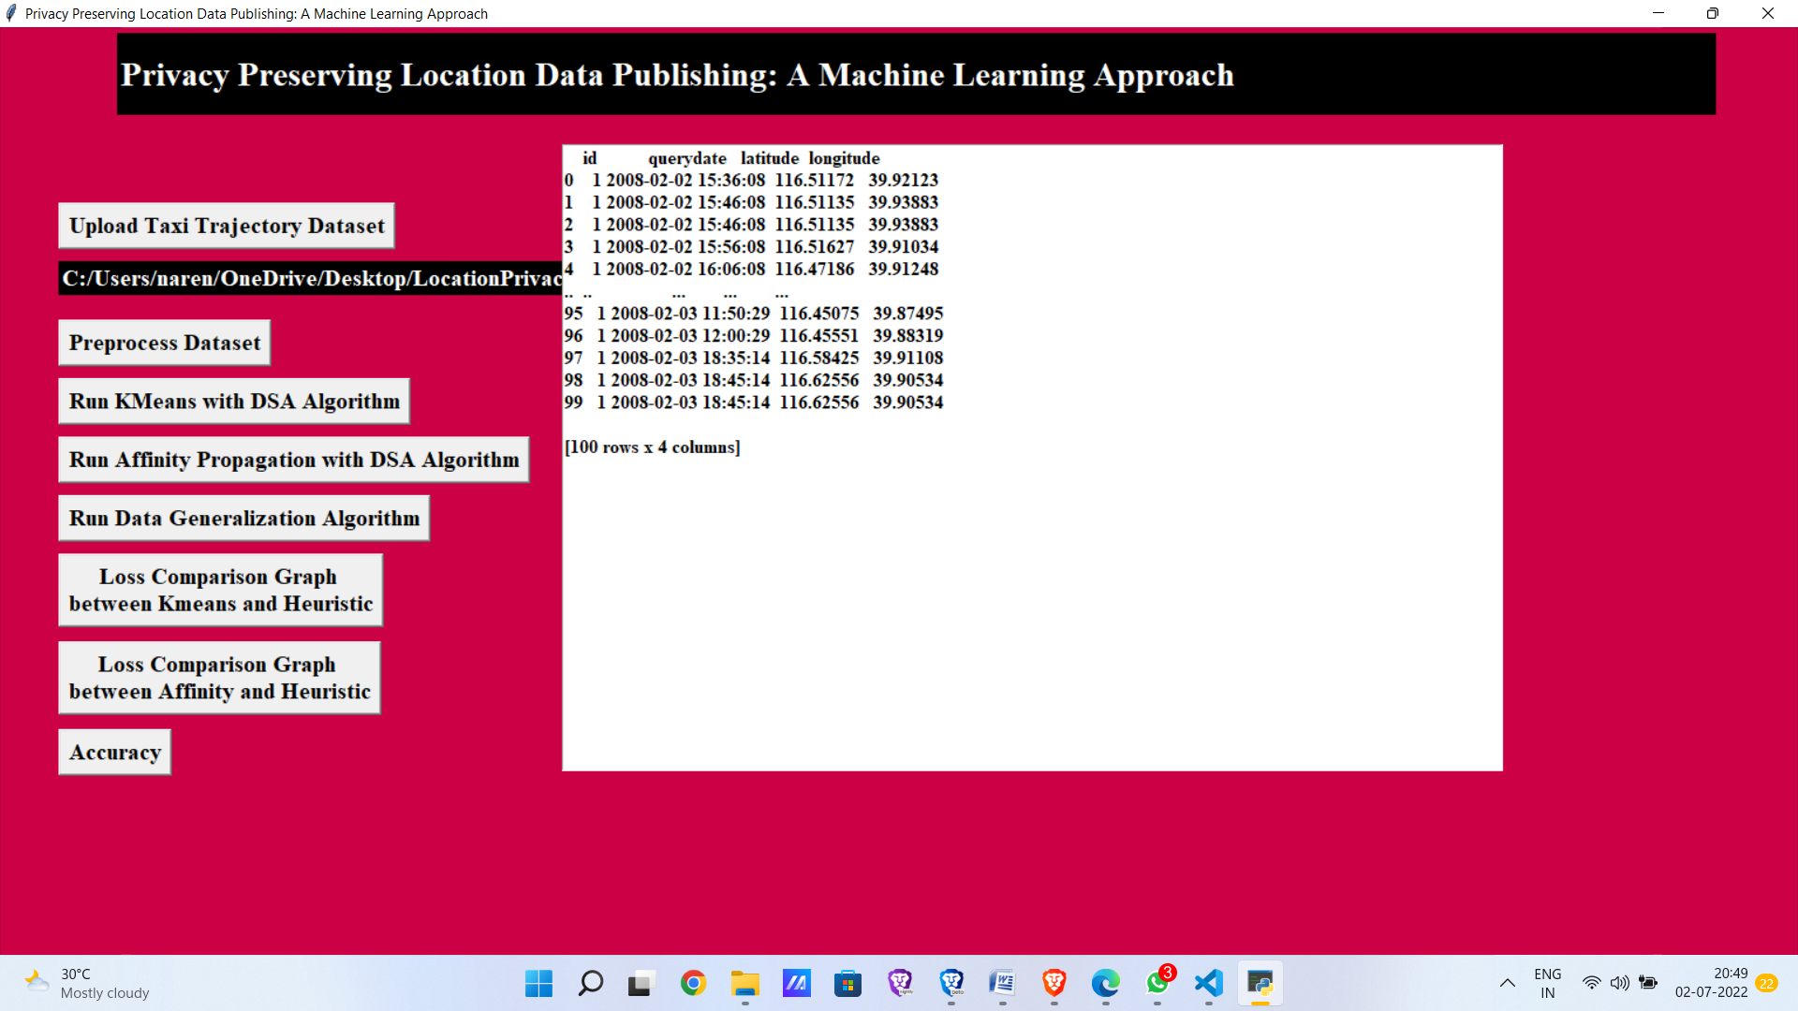
In above screen dataset loaded and now click on ‘Preprocess Dataset’ button to remove empty values and then extract latitude and longitude location from above dataset.

Slide 21
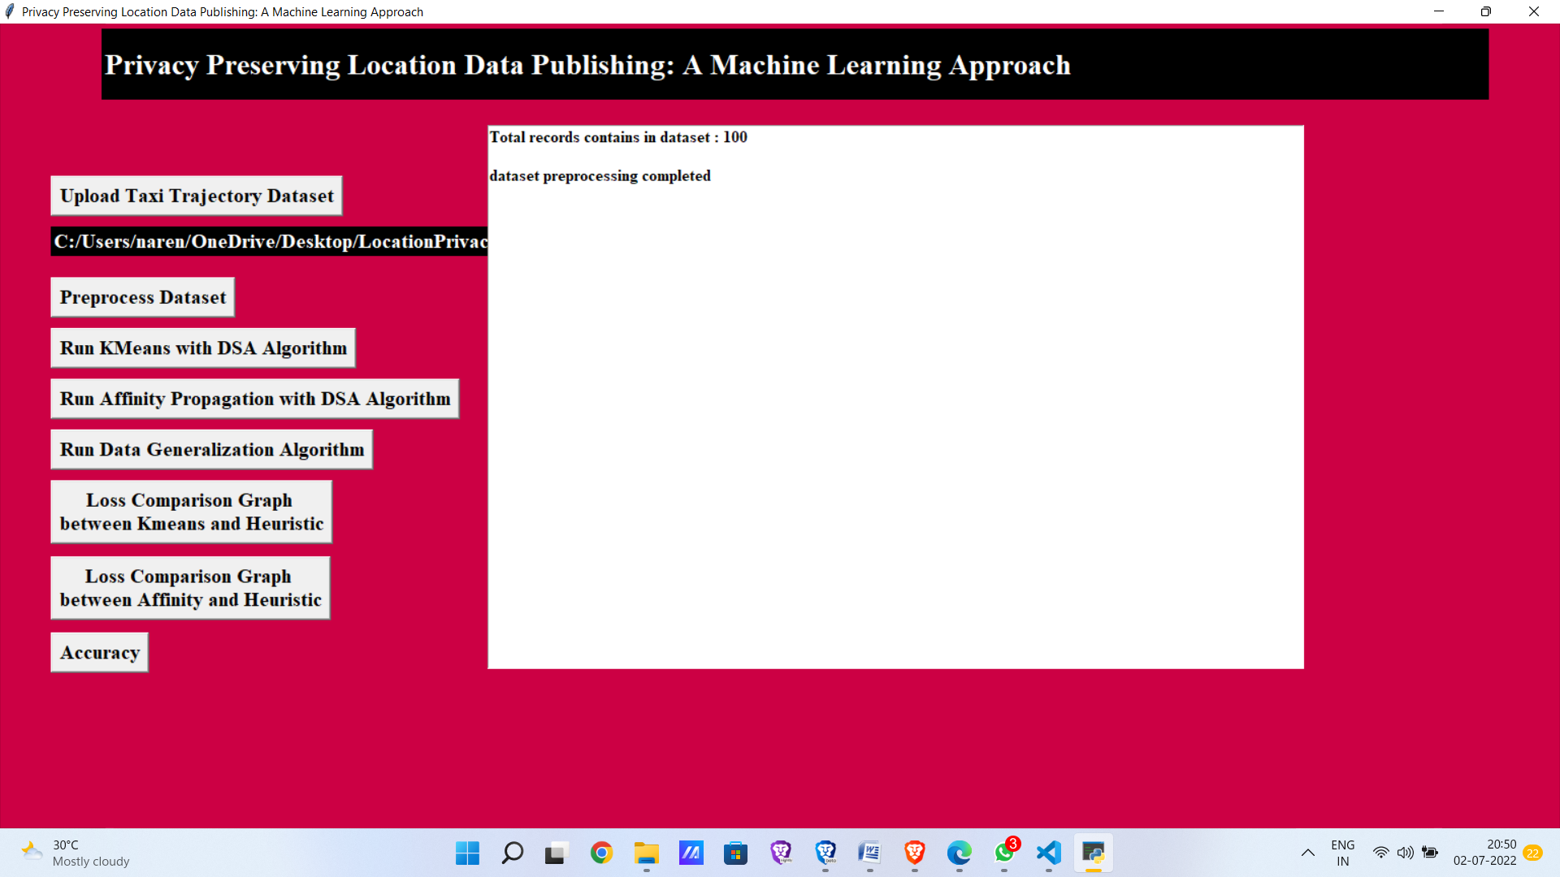
In above screen dataset pre-processing completed and now click on ‘Run KMeans with DySA Algorithm’ button to run KMEANS on dataset with Dynamic SA. This algorithm will group all similar location into same cluster and then perform Dynamic SA.

Slide 22
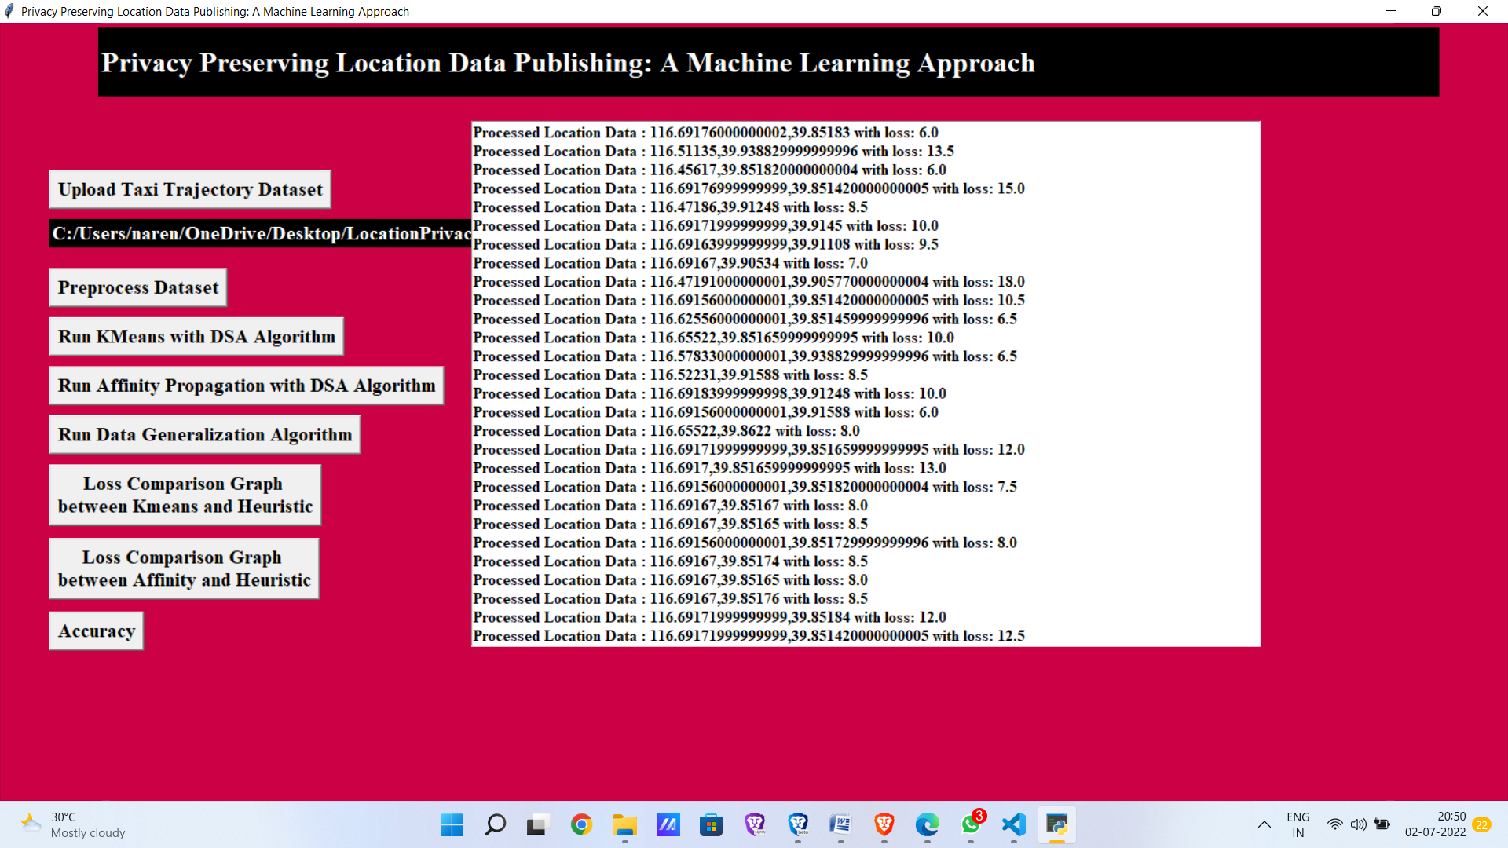
In above screen each location is processed and then calculating loss value with dynamic sequence alignment which align two locations by choosing minimal loss location.

Slide 23

In above screen KMEANS loss is 0.09 and Heuristic Clustering (also known as Dynamic SA) loss is 0.24. Now click on ‘Run Affinity Propagation with DSA Algorithm’ button to run Affinity Propagation on dataset with Dynamic SA.

Slide 24
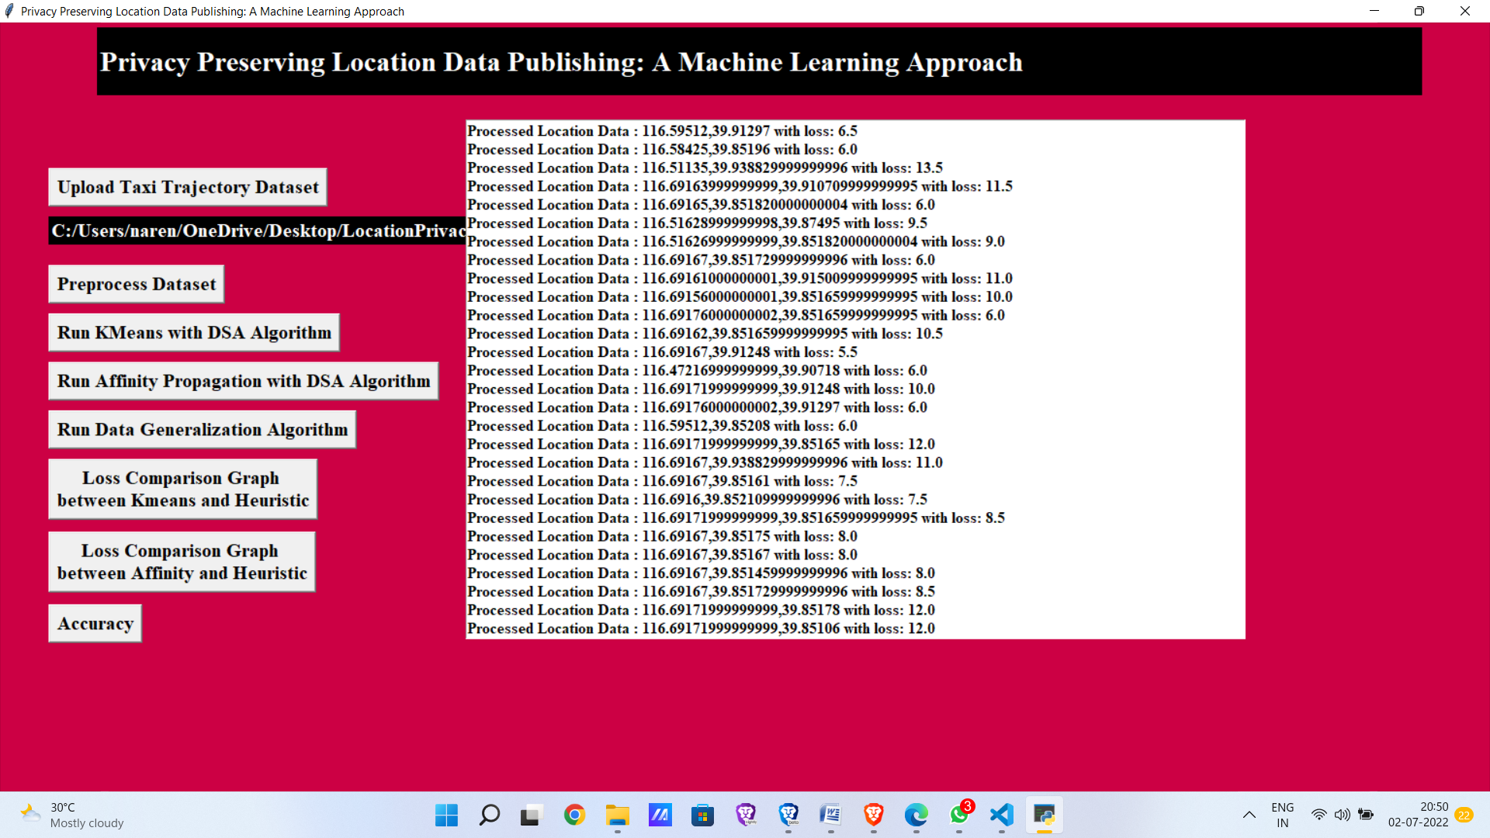
Affinity Propagation, unlike other standard clustering algorithms, does not require you to provide the number of clusters.

Slide 25

In above screen Affinity Propagation loss is 0.09 and Heuristic Clustering loss is 0.99.
Now click on ‘Run Data Generalization Algorithm’ button to generalized data with loss value.

Slide 26
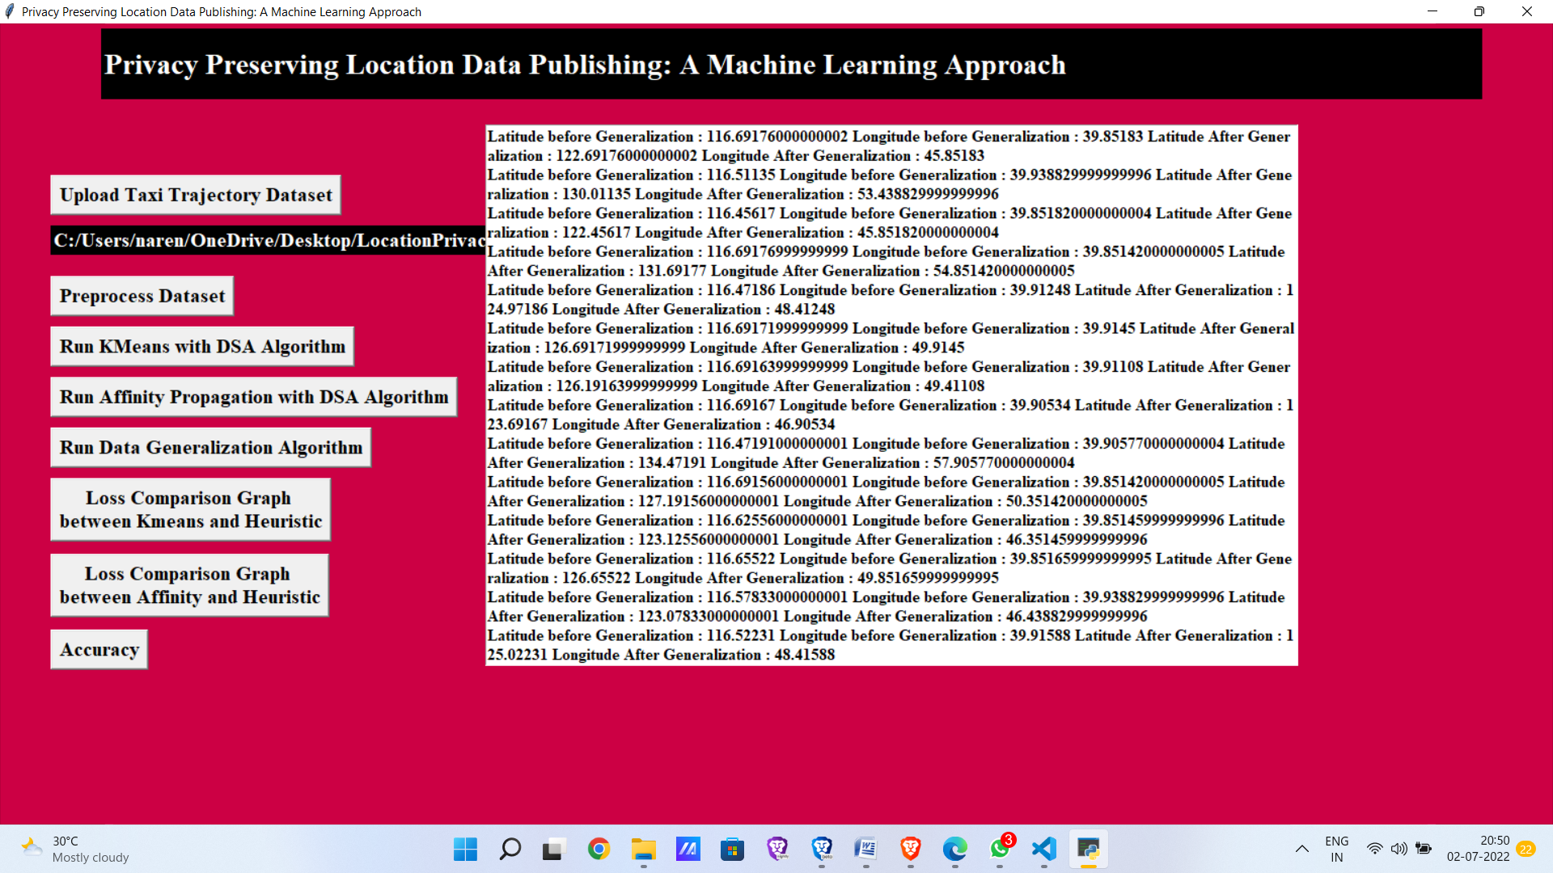
In above screen in first record you can see real location values from dataset and in next same location was generalized with loss value. Now click loss comparison graph b/t kmeans and heuristic.

Slide 27
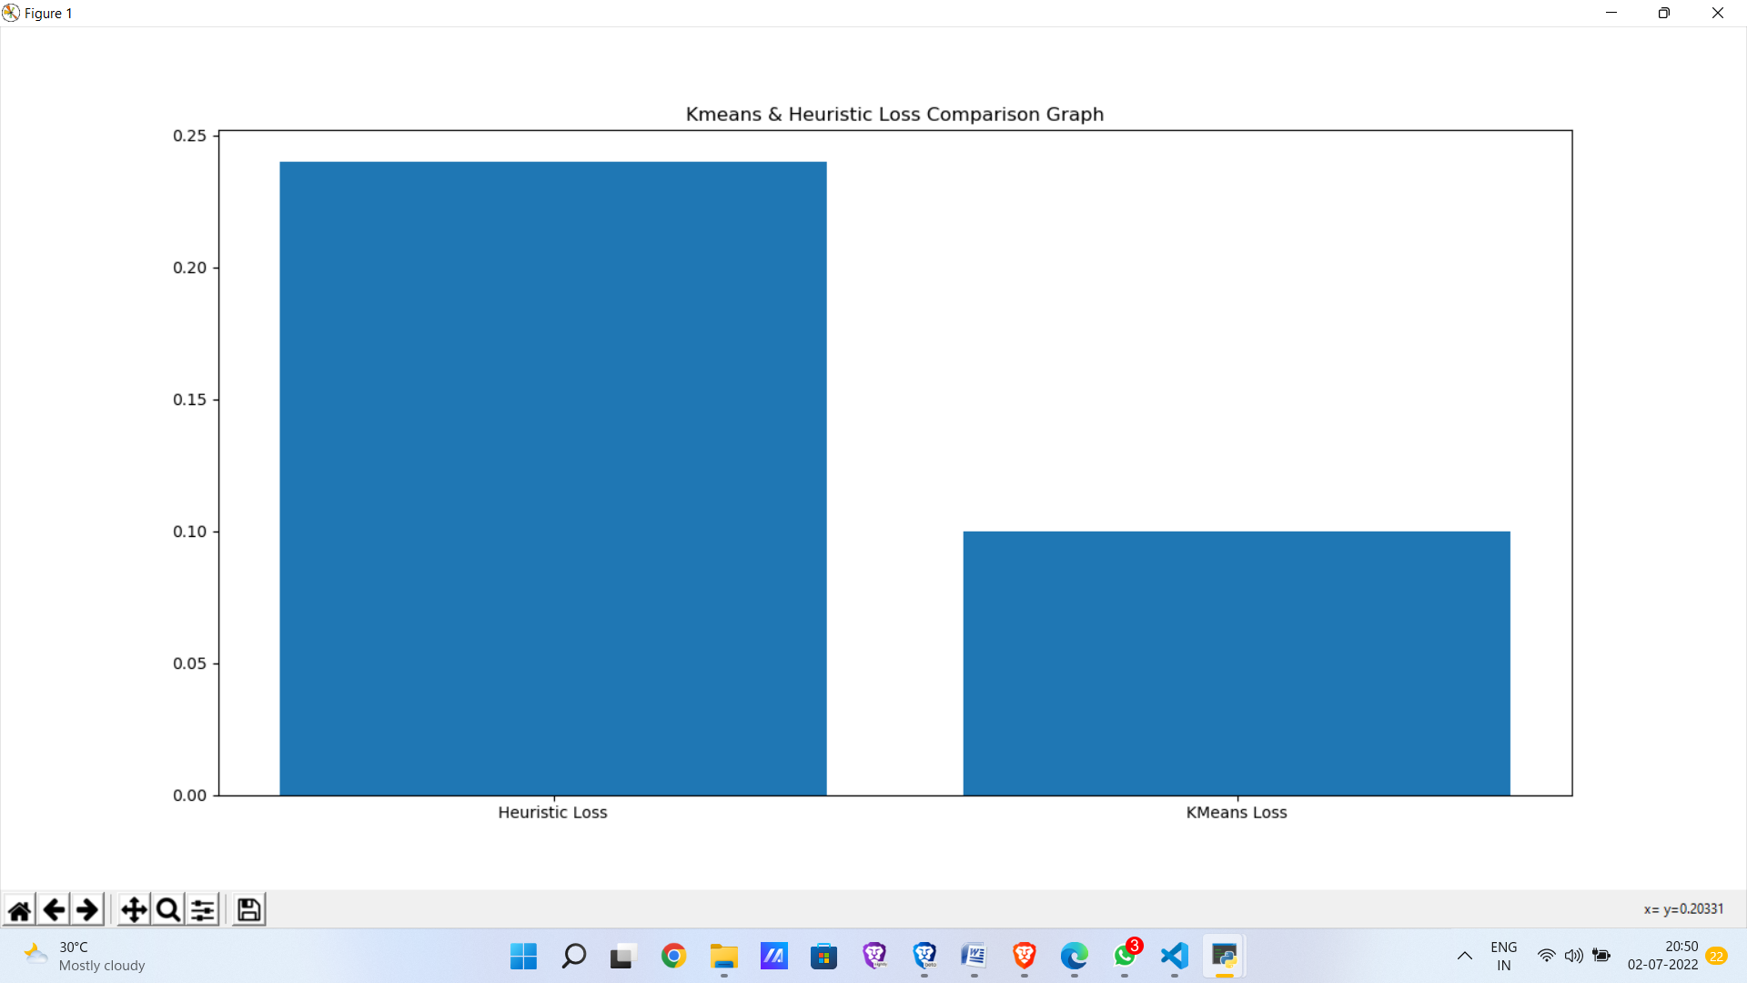
Now click loss comparison graph b/t Affinity propagation and heuristic.

Slide 28
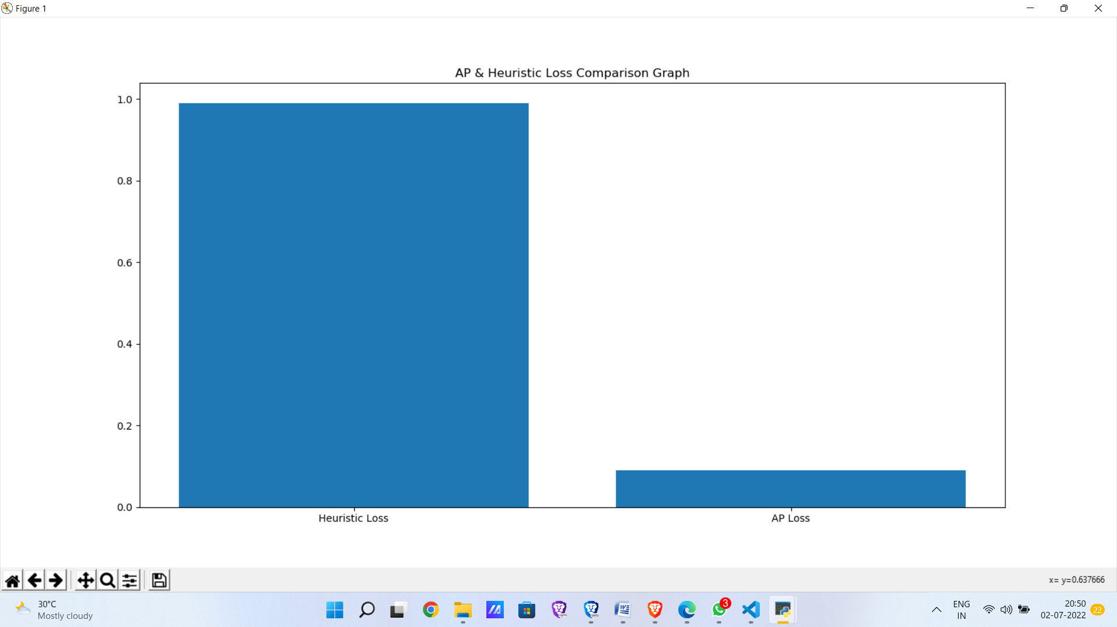
Now click Accuracy.

Slide 29

Accuracy indicates how much the predicted value is closer to the correct value in percentage . Higher the accuracy indicates better the algorithm.
In the above screen it shows K-Means accuracy is 90%, Affinity propagation accuracy is 91% and final Heuristic accuracy is 76%.

Slide 30
CONCLUSION
.
While releasing the spatiotemporal trajectories, we have provided a system to protect user privacy. Progressive sequence alignment, an effective alignment technique, and a machine learning clustering strategy that strives to minimize loss throughout the anonymization process are the foundations of the suggested solution. Additionally, in order to ensure k-anonymity in excessively sensitive datasets, we developed a variant of the k-means method. The experimental outcomes on actual GPS datasets demonstrate that our suggested methodology outperforms earlier efforts in terms of spatial usefulness.

Slide 31
THANK YOU

